Slide 1
RAILWAY RESERVATION SYSTEM BCA-VIII
Group Members:
Sujit manandhar(381958)
Subash Rana magar(382598)

Slide 2
CONTENTS
INTRODUCTION
OBJECTIVES
PROGRAMMING PLATFORM
FEATURES
SYSTEM DESIGN
CONTEXT DIAGRAM
ER DIAGRAM

Slide 3
INTRODUCTION
Railway Reservation System facilitates the passenger to enquire about the trains
available on the basis of source and destination,
booking and Cancellation of tickets,
enquire about the status of the booked ticket,
The aim of case study is to design and develop a database maintaining the record of different trains, train status and passenger. Our website has various kinds of information that helps regarding booking of tickets via railways.

Slide 4
OBJECTIVES
1. This system aims to develop a Railway Reservation that allows railway customers to manage their reservations,
2. To fully automate the process of issuing a railway ticket,
3. To reduce Ticket collectors burden over his job,
4. To design and develop a database maintaining the record of different trains, train status and passenger

Slide 5
Programming Platform
Project Name: | Railway Ticket Reservation System
Languages Used: | Python Django
Python version(Recommended): | 3.10.5
Database: | PostgreSQL
Type: | Web Application

Slide 6
FEATURES
Features of Railway Reservation System in Django in admin side:
Login – To gain access to the system, the administrator must first log in.
Manage Reservations – The admin has the ability to manage and view customer reservations.
Train – The admin has the ability to add, amend, and delete information about the train.
Station – The admin has the ability to add, amend, and delete information about the station.
Routes – The admin has the ability to add, update, and delete information about routes

Slide 7
FEATURES
Features of Railway Reservation System in Django in frontend side:
Register – The customer must first register in order to create an account before registering.
Login – After creating an account, the consumer must log in to gain access to the entire system.
Search Trains – The user has the option of searching all of the available trains.
Reservations – The consumer can make reservations for available trains.
Cancellation of Reservations – The customer has the option to cancel his or her reservation.

Slide 8
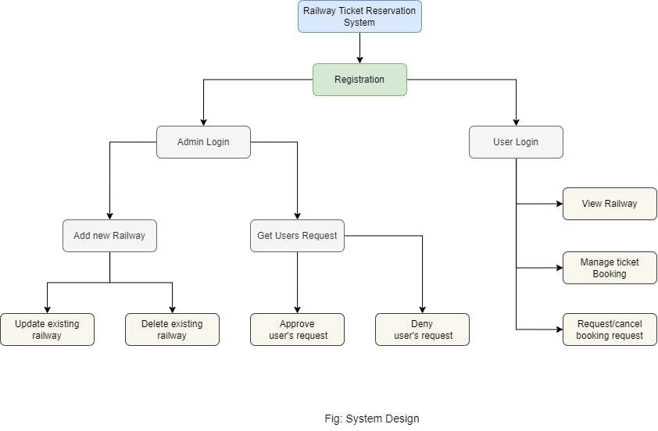

Slide 9
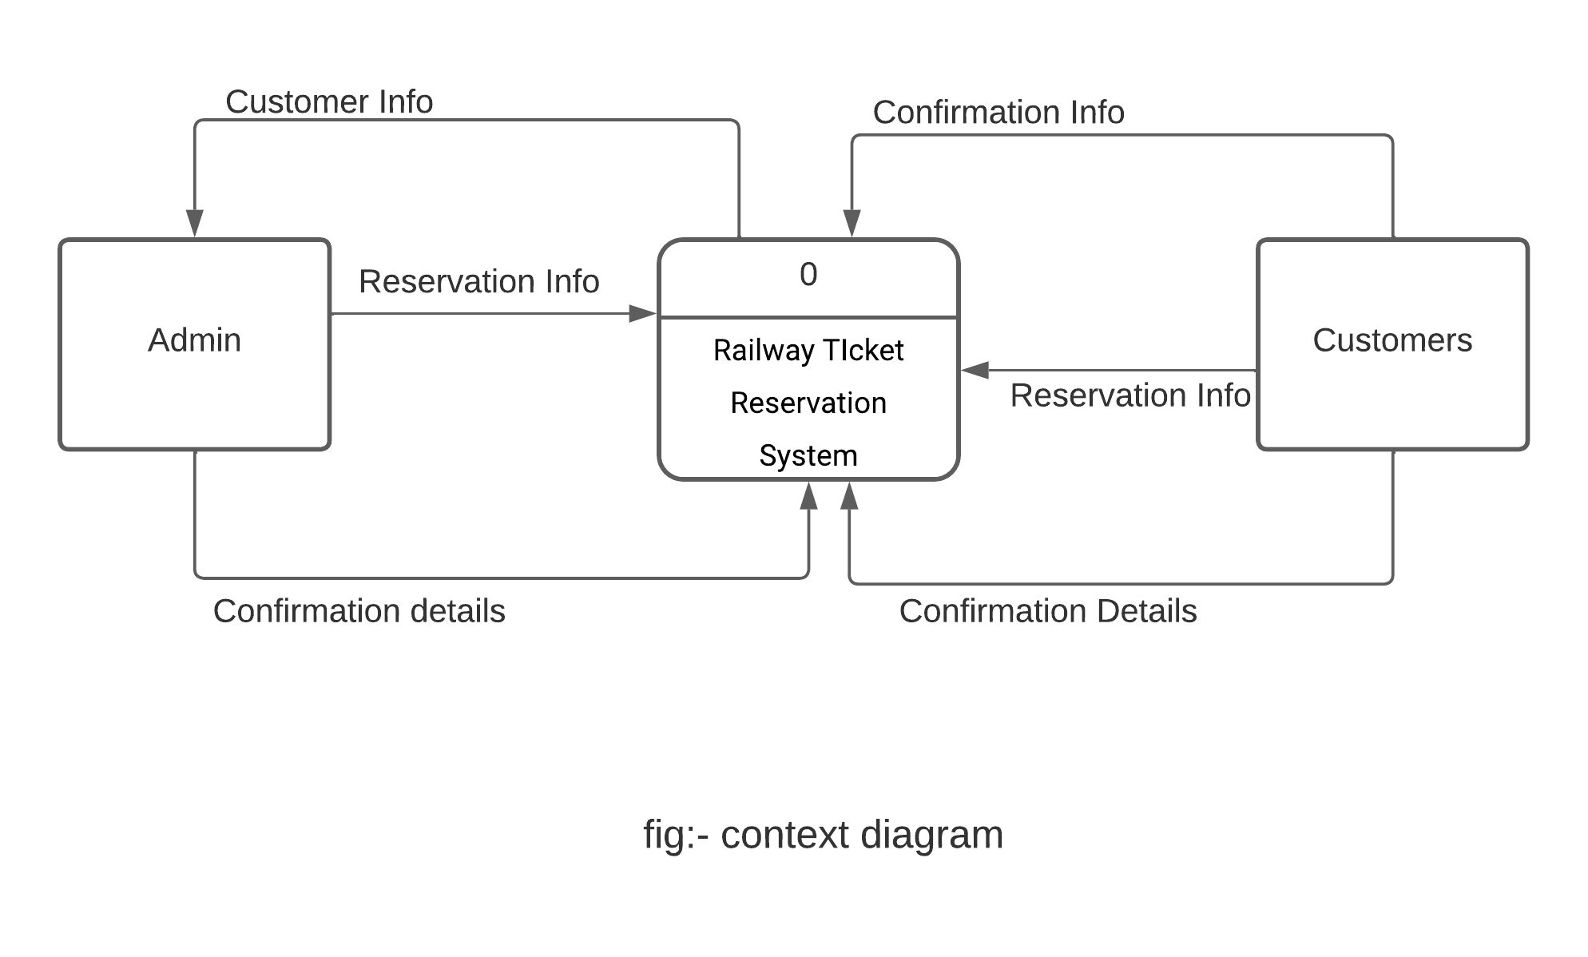

Slide 10
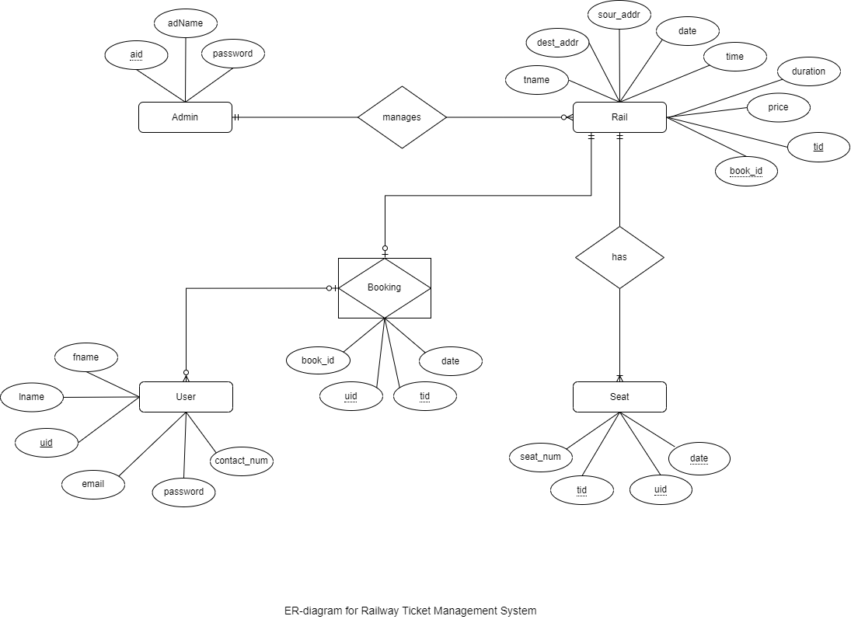

Slide 11
Thank You

